Slide 1
Md. Rokanujjaman
Professor
Dept. of CSE
University of Rajshahi
01712043386, rokon_cstru@yahoo.com

Slide 2
Areas Of Security
Authentication
  Verifying your identity using passwords/pass phrases and certificates
Confidentiality
Non Repudiation
  Method by which the sender of data is provided with proof of delivery and the recipient is assured of the senders identity

Slide 3
Areas Of Security
Integrity
Access Control
  Mechanisms and policies that restrict access to computer resources
Availability

Slide 4


Security Problems
Spoofing
“How can I be certain that my personal information is not altered by online eavesdroppers when they enter into a secure transaction on the Web?”
“How can I be certain that my customers’ account number information is not accessible to online eavesdroppers when they enter into a secure transaction on the Web?”
“How can I reassure customers who come to my site that they are doing business with me, not with a fake set up to steal their credit card numbers?”
PROBLEMS
Data Alteration
Eavesdropping

Slide 5

What Do We Have to Achieve
Authentication
no spoofing
Non-repudiation
no claiming
of user action
Privacy
no eavesdropping
Data Integrity
no data alteration

Slide 6

How to Achieve It?
Cryptography algorithms to provide privacy.
Digital Certificates and Digital Signatures
for Web servers, to provide authentication.
data integrity, and non-repudiation service.
Secure Sockets Layer (SSL) uses all these techniques
to achieve trusted communication.
When URL begins with https it identifies the site as “secure”
(meaning that it encrypts or scrambles transmitted information)

Slide 7

Cryptography Basics
Cryptography provides privacy
ENCRYPTED
MESSAGE
(CYPHERTEXT)
ENCRYPTION ALG.
DECRYPTION ALG.
MESSAGE
(PLAINTEXT)
MESSAGE
(PLAINTEXT)
SENDER
RECEIVER
KEYS
Symmetric approach
Asymmetric approach
Hybrid approach

Slide 8
Symmetric Approach
Both sides use the same key for encryption and decryption
ENCRYPTED
MESSAGE
(CYPHERTEXT)
SYMMETRIC KEY
SYMMETRIC KEY
MESSAGE
(PLAINTEXT)
MESSAGE
(PLAINTEXT)
SENDER
RECEIVER
Convenient for bulk data encryption
(computationally faster than other methods)
Problem: key distribution

Slide 9
Asymmetric Approach
Sender uses public key for encryption,
receiver uses private key for decryption
ENCRYPTED
MESSAGE
(CYPHERTEXT)
PUBLIC KEY
PRIVATE KEY
MESSAGE
(PLAINTEXT)
MESSAGE
(PLAINTEXT)
SENDER
RECEIVER
Convenient for short data encryption
(computationally slower then other methods)
Problem: binding the public key and its owner.

Slide 10



Hybrid Approach
Uses asymmetric approach for passing the symmetric key
Uses symmetric approach for data encryption
+
=
This approach is applied in SSL

Slide 11
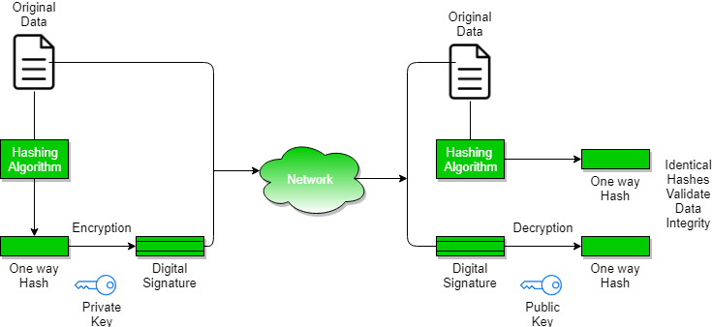
Authentication
Digital Signature
  A digital signature is a mechanism that is used to verify that a particular digital document, message or transaction is authentic. It provides a receiver the guarantee that the message was actually generated by the sender and it was not modified by a third

Slide 12
Authentication
Digital Signature
The steps followed in creating digital signature are :
Message digest is computed by applying hash function on the message and then message digest is encrypted using private key of sender to form the digital signature. (digital signature = encryption (private key of sender, message digest) and message digest = message digest algorithm(message)).
Digital signature is then transmitted with the message.(message + digital signature is transmitted)
Receiver decrypts the digital signature using the public key of sender.(This assures authenticity, as only sender has his private key so only sender can encrypt using his private key which can thus be decrypted by sender’s public key).
The receiver now has the message digest.
The receiver can compute the message digest from the message (actual message is sent with the digital signature).
The message digest computed by receiver and the message digest (got by decryption on digital signature) need to be same for ensuring integrity.

Slide 13
Authentication
Digital Certificate
  Digital certificate is issued by a trusted third party a certification authority (CA) which proves sender's identity to the receiver and receiver’s identity to the sender.
  The CA controls the Public Key Infrastructure (PKI).
  A security certificate ,associates an identity with a public key. Only the owner knows the corresponding private key that allows the owner to "decrypt" or make a digital signature.
  Eg Barclays UK’s Digital certificate

Slide 14
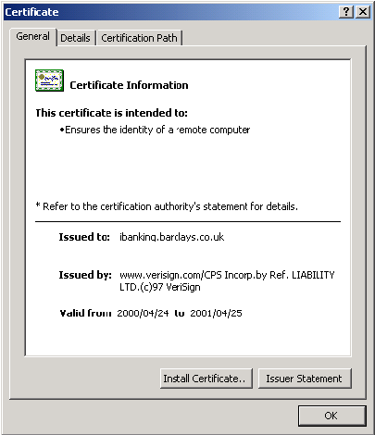
Digital certificate contains:
Name of certificate holder.
Serial number which is used to uniquely identify a certificate, the individual or the entity identified by the certificate
Expiration dates.
Copy of certificate holder's public key.(used for encrypting messages and digital signatures)
Digital Signature of the certificate issuing authority.

Slide 15
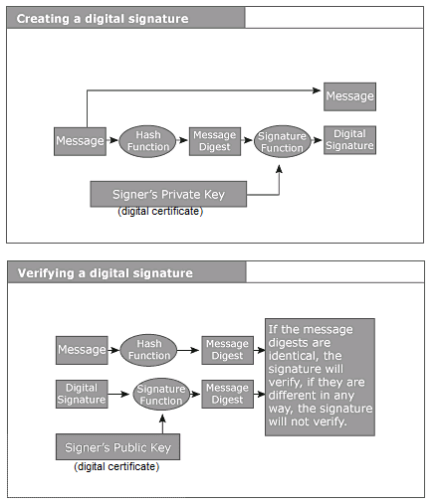
Authentication

Slide 16
Thank You

